Slide 1
Process & Thread (Intro)
07/07/2021

Slide 2
A reminder
In order of fast access:
Registers
Cache (sRAM)
RAM (dRAM)
Disk (C:, D:)

Slide 3
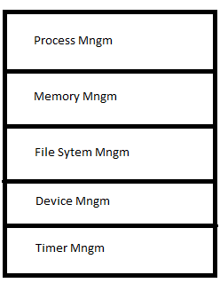
OS in more detail
The process management sector deals with the entities (Process and Threads) and performs actions that deal with:
Mutual Exclusion
Synchronization
Communications

Slide 4
Found User Commands
Shell takes commands and searches for the program in your PATH
If it’s found, the loader copies the user program from disk to dRAM in whatever empty free space is available
Loader then splits the linked sections (text, heap, etc) into the corresponding OS denominations (text, heap, etc again)
PC is then pointing to the starting address of the program
CPU runs the program (5 Stages → fetch, decode, execute, mem, etc)

